Slide 1
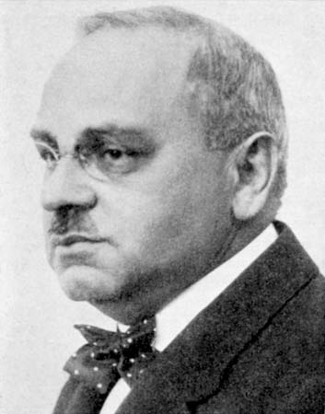
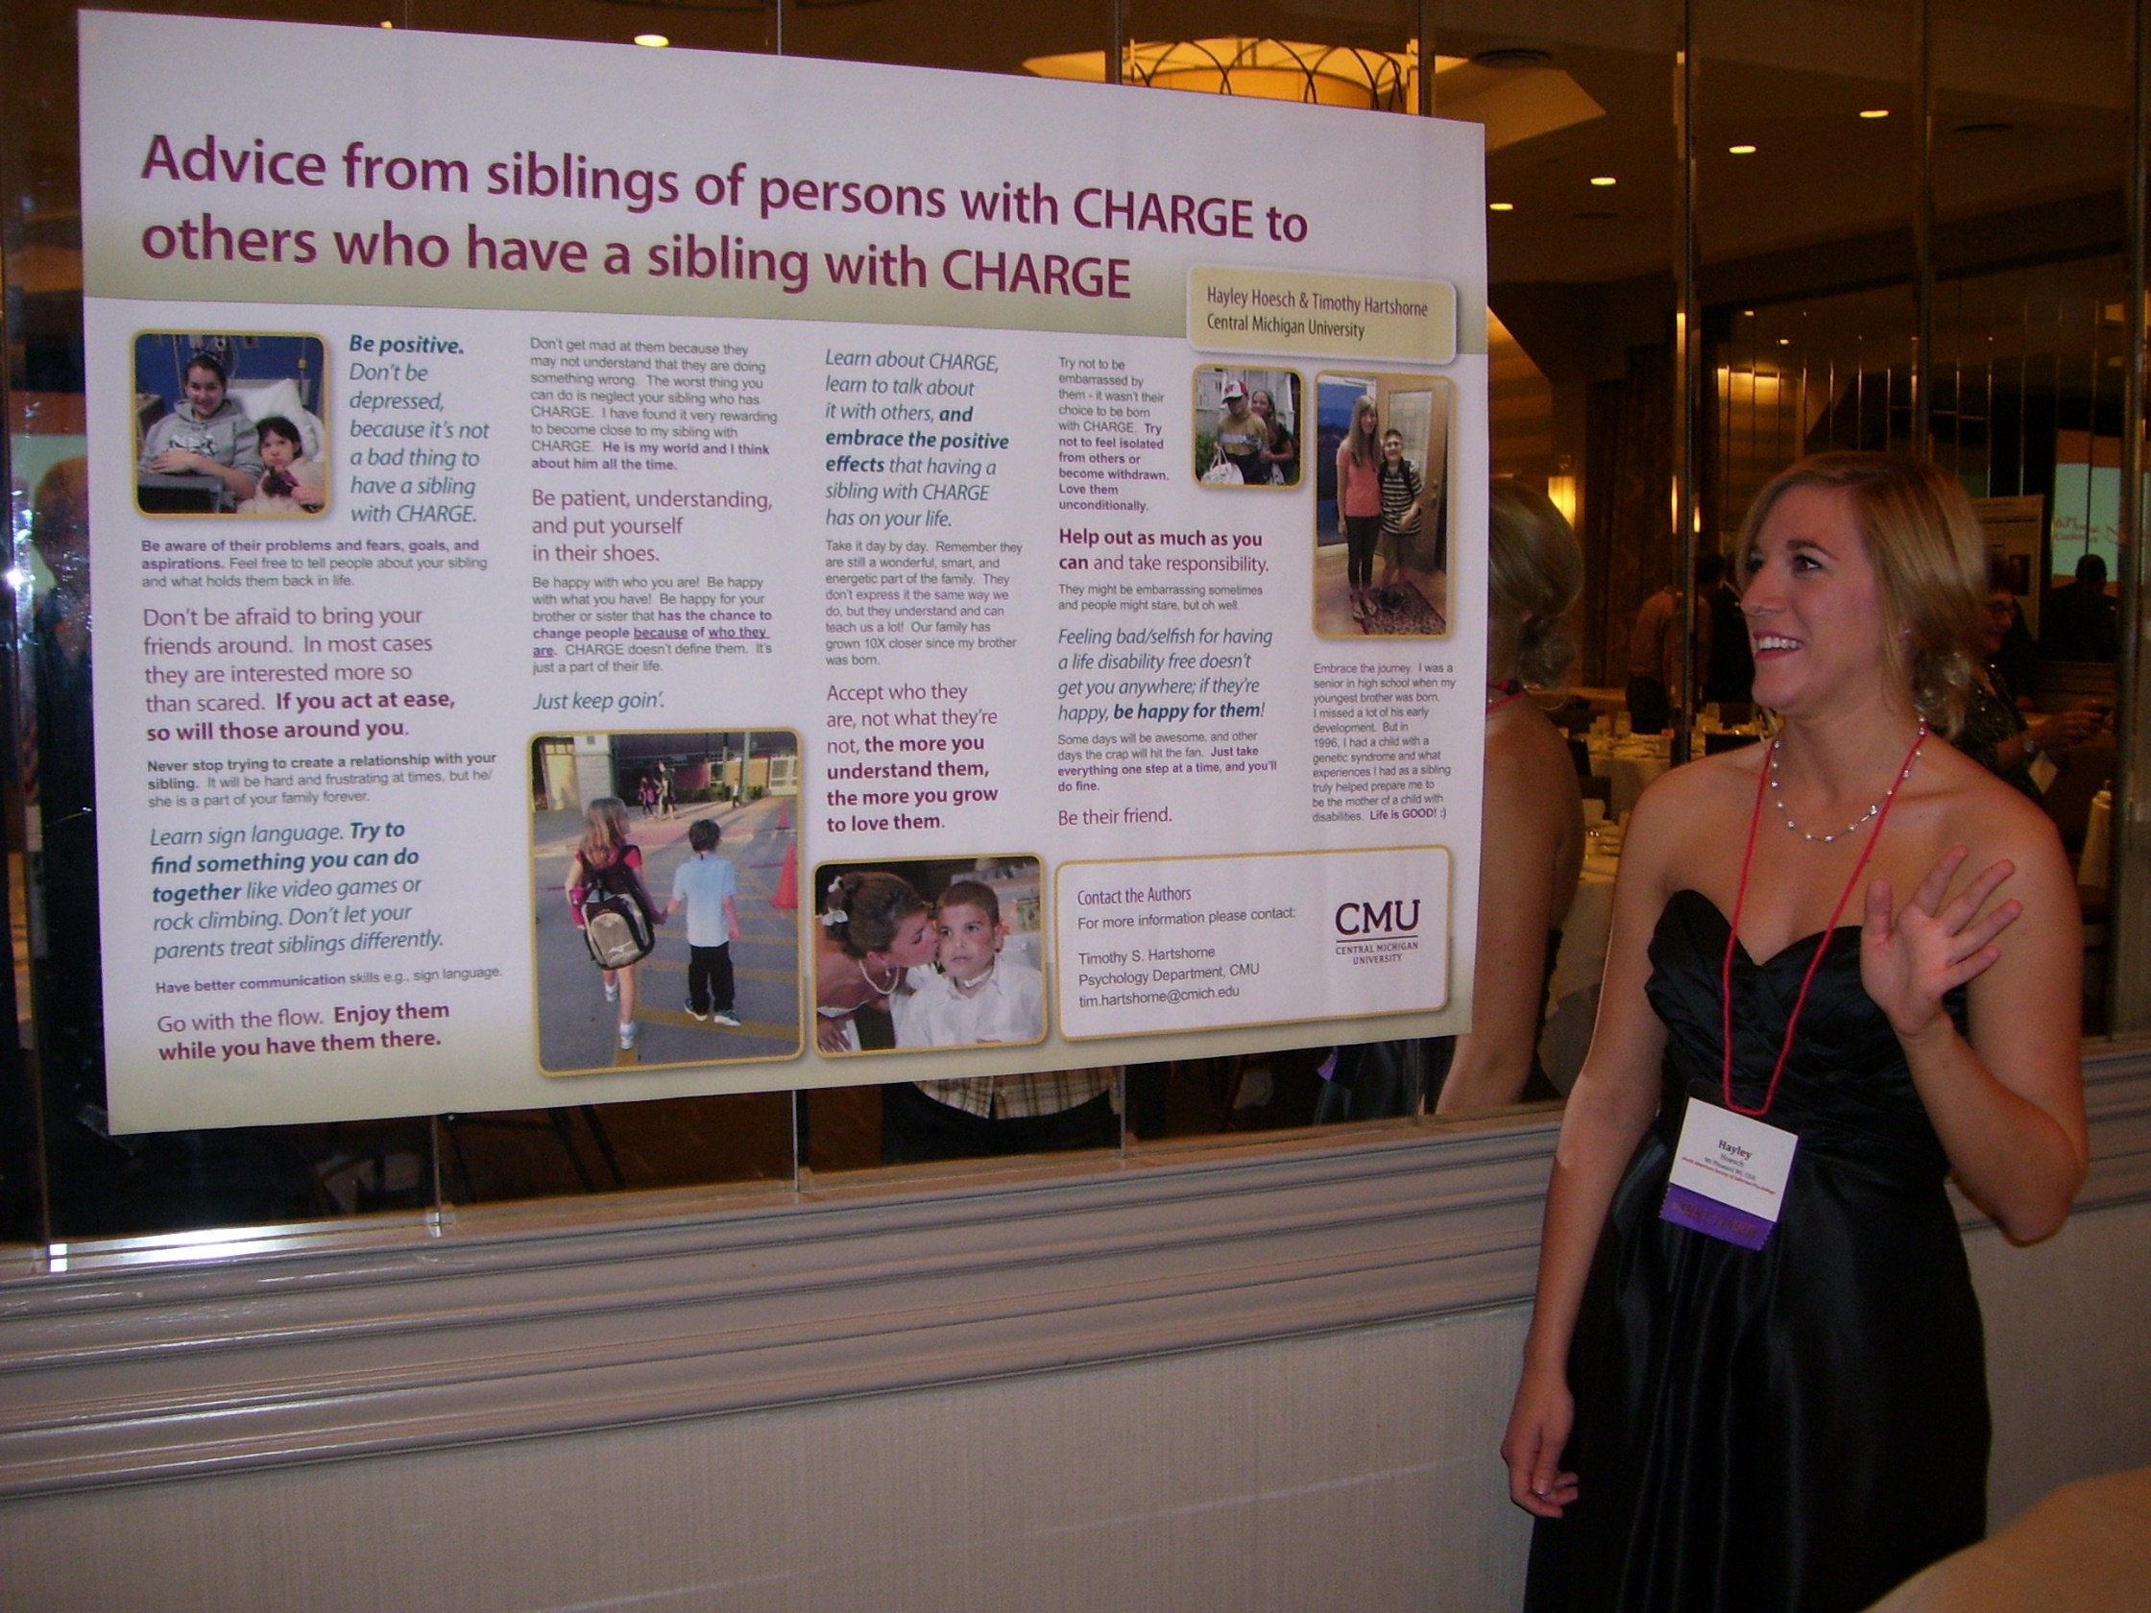
Theory, Research, and Teaching Section
Korey Watkins and Tim Hartshorne, Section representatives
Introduction
Activities
The Theory, Research, and Teaching Section (TRT) encourages the theoretical development of Alfred Adler's Individual Psychology through scholarly research and the teaching of this orientation at the undergraduate and graduate levels. We provide symposiums and presentations, facilitate meetings at our annual convention, and support one another as we extend the scientific and academic frontier of Individual Psychology. Members of the TRT Section join together, regardless of focus or application, and strive to keep Individual Psychology relevant and applicable.
Conference
We review and rank all of the conference presentations proposals that are submitted to our section. At the fall COR meeting we make our recommendations for acceptances.
We award conference scholarship money to applicants who have specifically applied to our section for support.
TapTalks
Tap stands for Teaching Adlerian Psychology
These monthly teleconferences feature a noted Adlerian talking on a topic related to their work
Poster Session
A more intimate presentation of your work.
Ideal for presentation of research
Opportunity to present new ideas and practice for feedback and reaction
Good forum for theses and dissertations
Encouragement
Theory discussion and building
Support of research
Teaching basic concepts
Communication among members
Honorary member of the section
Conclusions
Objectives
“And Individual Psychology? Has it not also its own particular conception of life? Has it not also a specific point of view regarding the behavior of the individual in his relation to outside problems? Of course it has,. But in the fist place we have tried to prove that our conception of life is more capable of objectivity than the conception of other psychologists. And secondly we know that we also are predisposed by our philosophy of life, while others do not know that they always find what they have known before. For this reason, Individual Psychology is more capable of detachment and self-control.”
Alfred Adler. Ansbacher, H. L., & Ansbacher, R. R. (1956) (Eds.). The individual psychology of Alfred Adler. New York: Basic Books, p. 199.
From our bylaws
To support and foster teaching in Individual Psychology
To stimulate interest in theory, research, and post-secondary teaching in Individual Psychology
To facilitate meetings, symposiums, and presentations for the Society
To foster the publications of materials on Individual Psychology for the members
To provide support to members who are teaching post-secondary courses on Individual Psychology

